Slide 1
Code of Conduct
Incident Response Training
Please change your Zoom name
to include your pronouns
(if you're comfortable sharing them)
It's under Participants, hover over your name,
click rename
CC NC-BY-SA
Otter Tech LLC
sharp@otter.technology

Slide 2
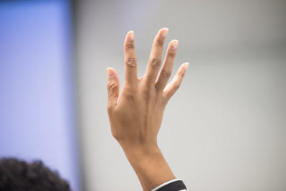
Workshop Format
Slide presentations
Please ask questions!
Use "raise hand" in Zoom
Breaks:
5 min break at 1:30 in
15 min break at 2:30 in
Public domain:
U.S. Department of Agriculture

Slide 3
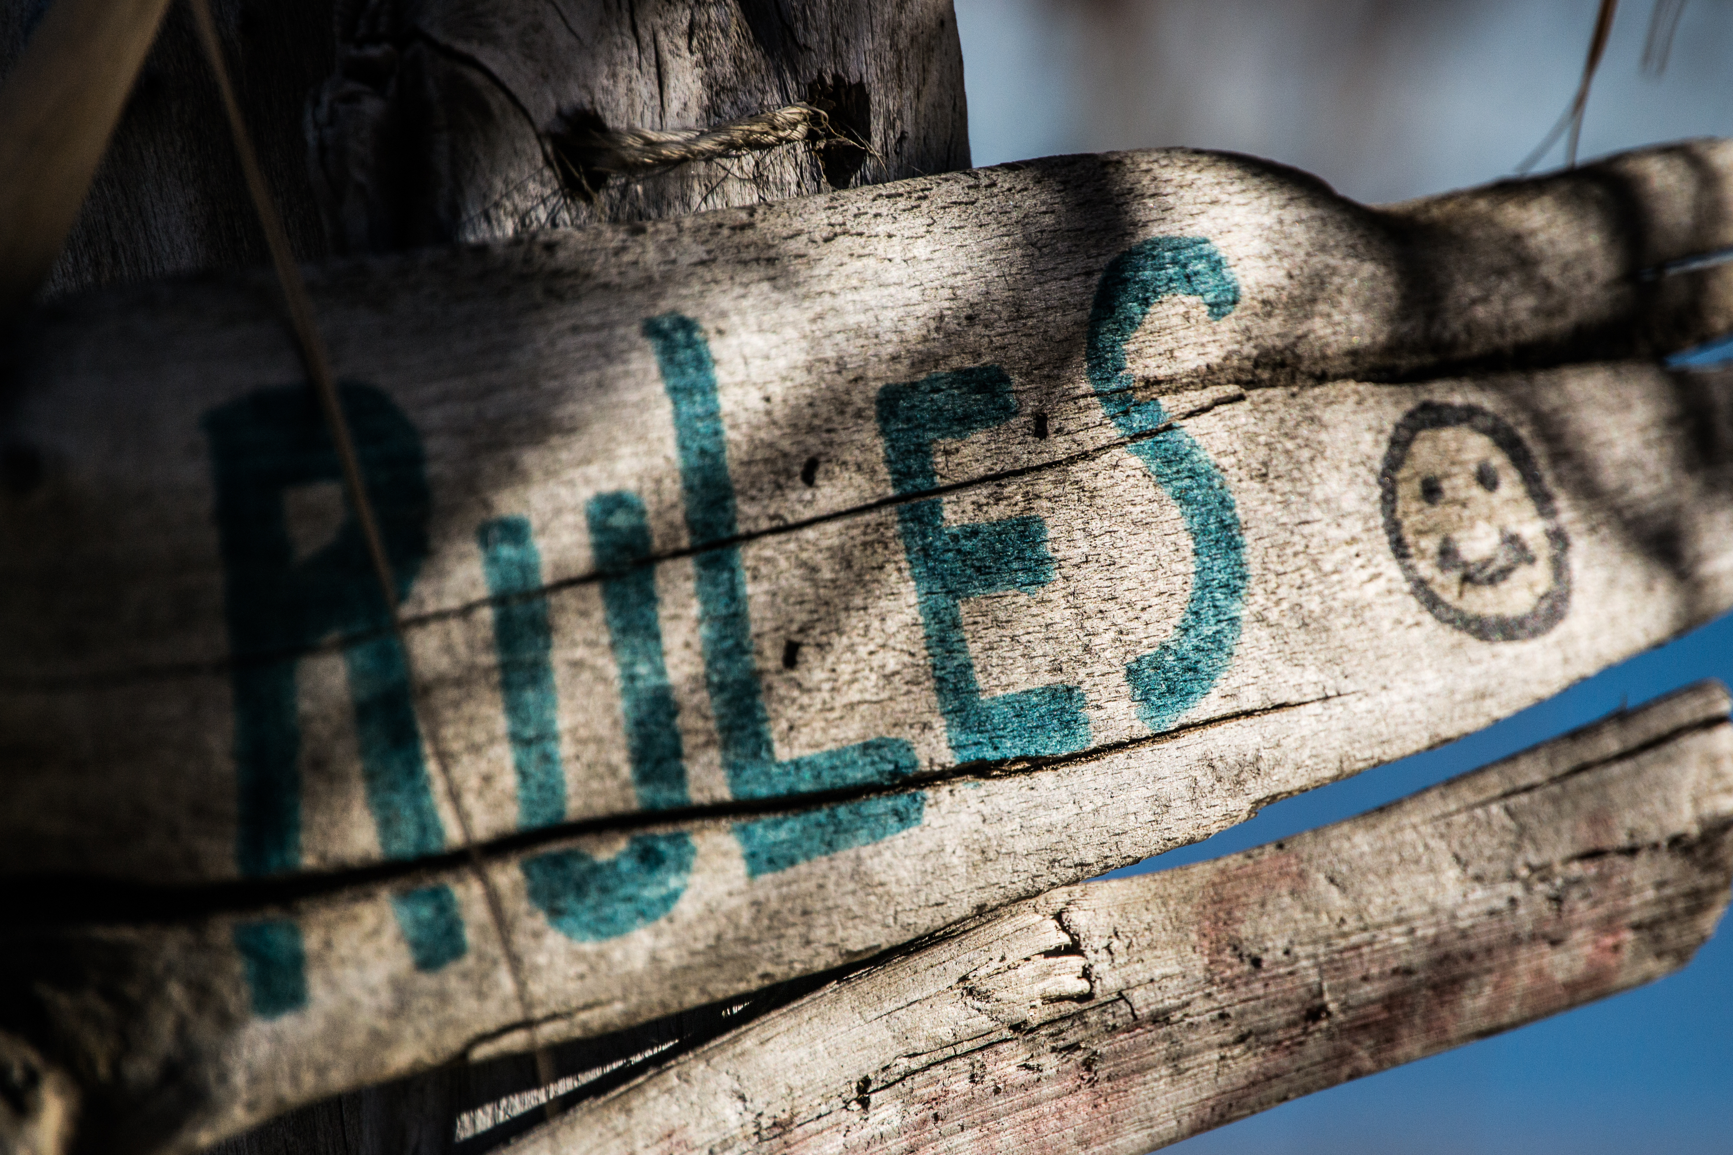
Ground Rules
This is a safe(r) space
If you are asked to stop, you will stop
You may leave at any time
Be open to new knowledge
Acknowledge different lived experiences
CC BY Steve Johnson

Slide 4
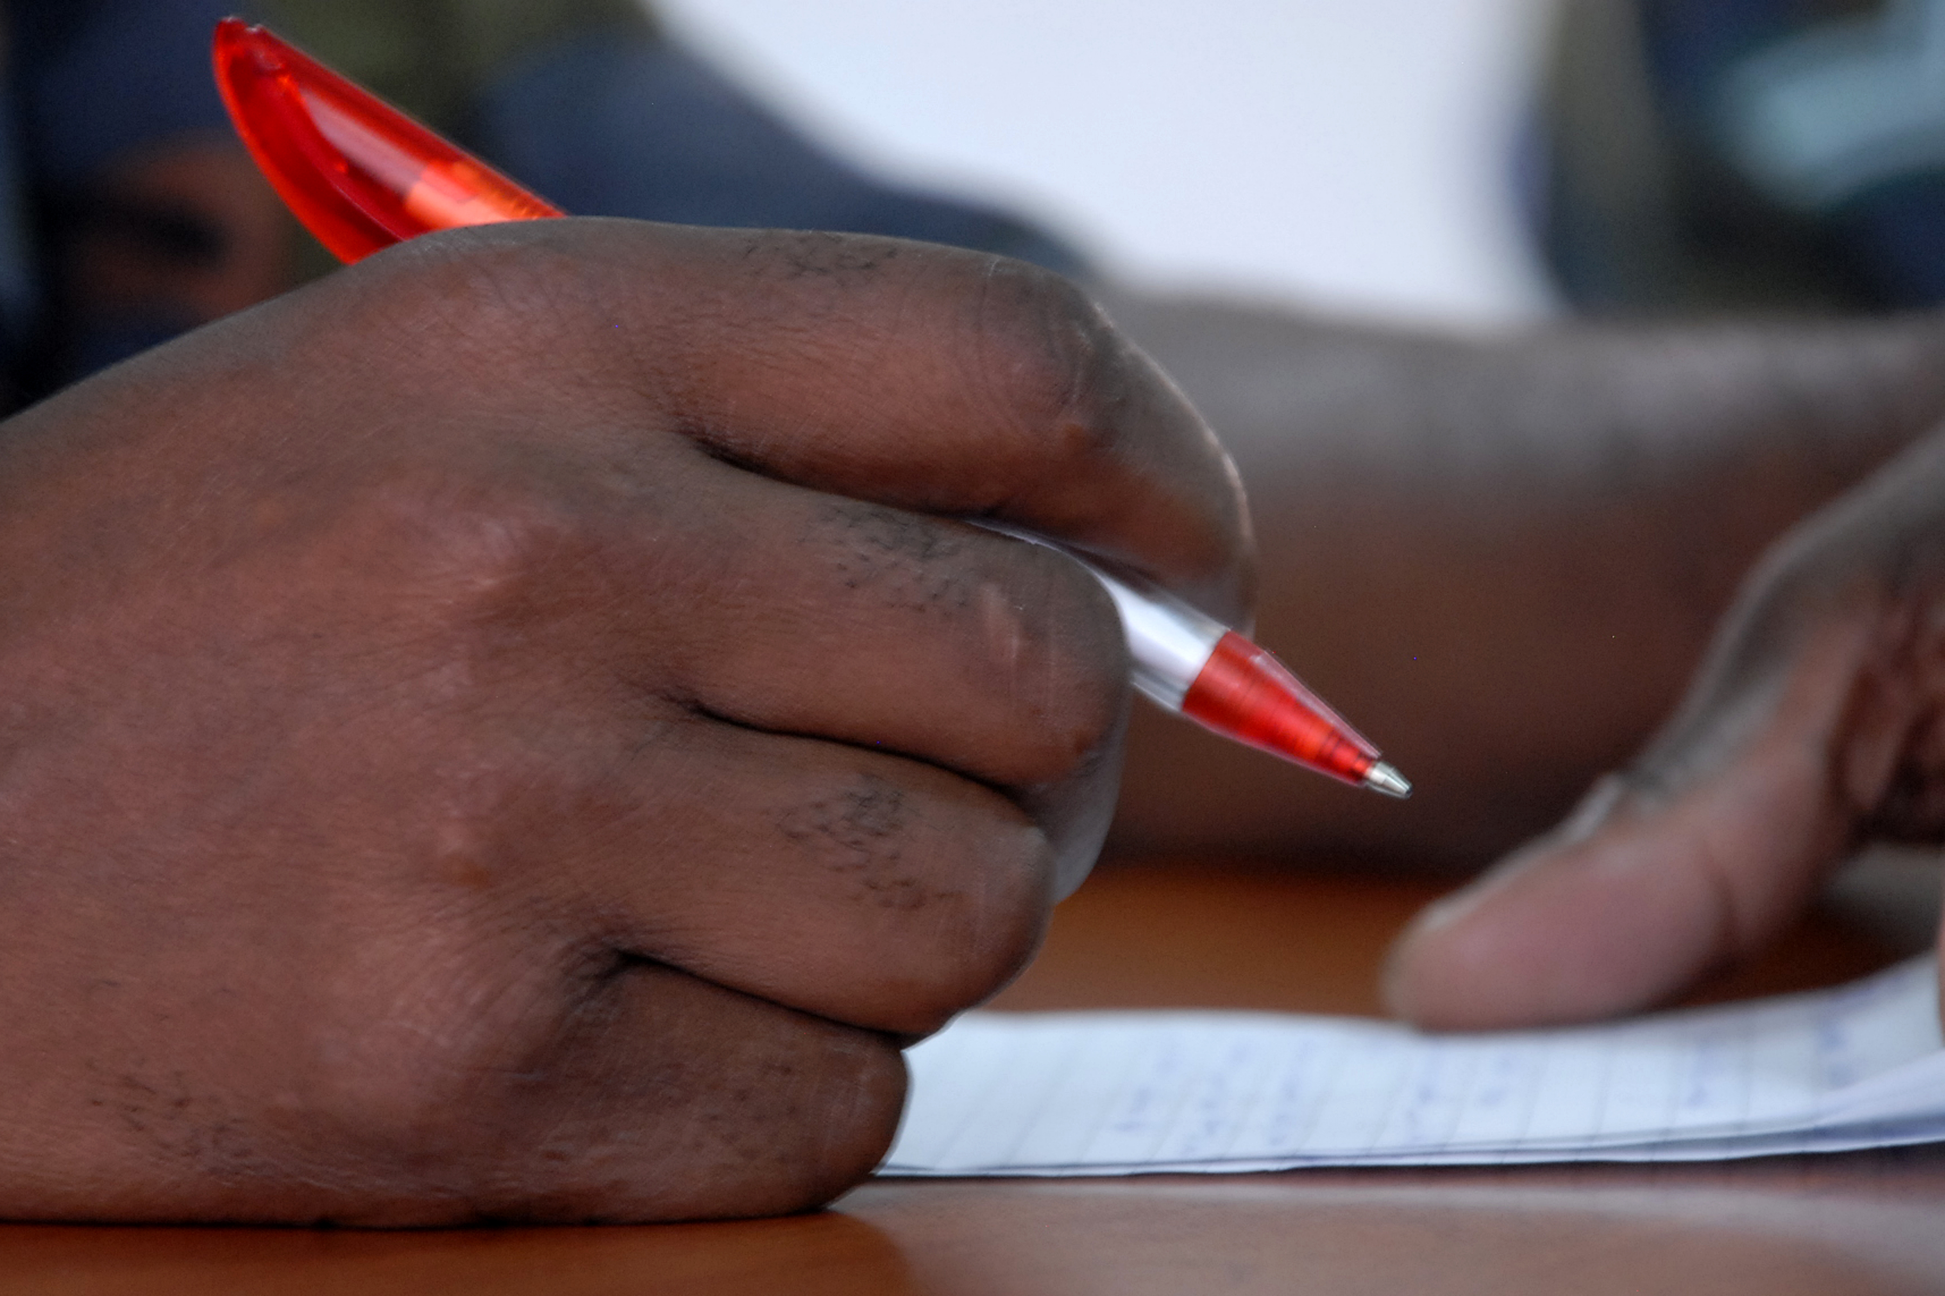
Vocabulary
Incident
Reporter
Reported person
Incident Responder
CC BY U.S. Army Africa

Slide 5
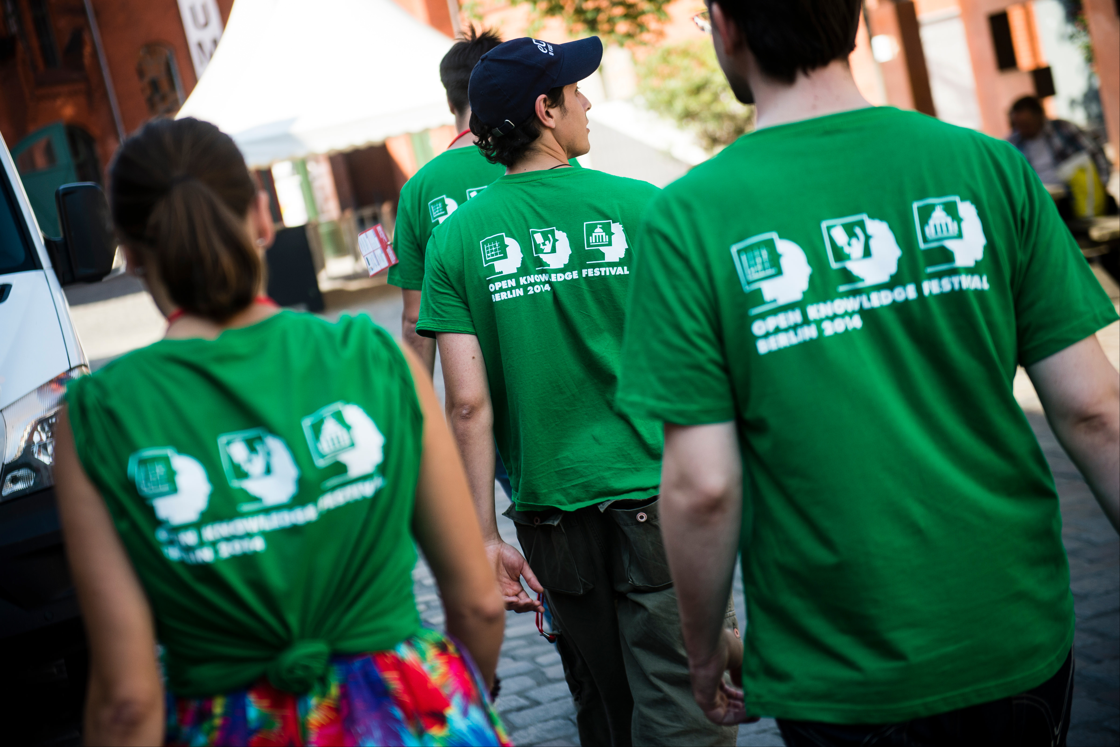
Incident Responder Duties
Workshop covers:
Taking an incident report
Protecting reporter privacy
Evaluating a report
Encouraging a change in behavior
Deciding consequences
Following up with reported person
Off topic:
Responding to impacted people
Documenting the incident
CC BY Open Knowledge

Slide 6
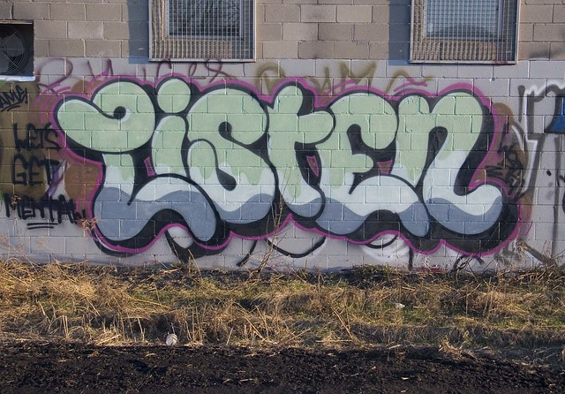
When taking a report
Do:
Listen
Ask clarifying questions
Acknowledge emotions
Thank the reporter
Next steps and timeline
Don't:
Judge the reported person
Promise any particular action
Ask how to handle the situation
CC BY painteverything

Slide 7
Acknowledging Reporter Emotions
You felt (emotion) when (behavior)
"You felt scared when their raised their voice."
Feels too direct? Try:
"So you felt (emotion) when (behavior)?"
"I'm hearing that you felt (emotion) when (behavior)."
"Nonviolent communication" by Marshall B. Rosenberg, PhD

Slide 8
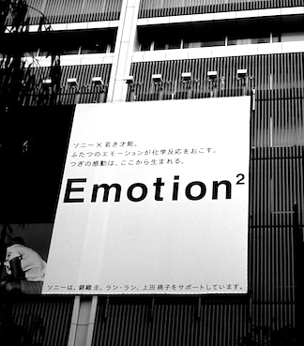
Common Reporter Emotions
Repeating themselves
Becoming flustered
Talking fast
Judgment words
Anger
Mistrust
Emotion CC BY 2.0 Osamu Kaneko

Slide 9
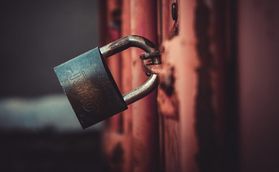
Handling Privacy Concerns
Report will be confidential
Take an anonymous report
Tell reported person a witness overheard / saw
Take an escrow report
Document report
Act after second report
Delay response to protect privacy of 2nd person
Don't mention multiple reports
Locked CC BY 2.0 montillon.a

Slide 10
Report Template
Most important:
How to identify the reported person
Reporter's contact info
Key points of the incident
Link to download report template

Slide 11
Taking an Incident Report: QUEST
Quiet place - offer a private room / private chat
Unsafe - call another incident responder
Emotions - "You felt (emotion) when (behavior)"
Security - how to protect reporter privacy & safety?
Trust - help the reporter feel more welcome
Thank the reporter. Get their contact info.

Slide 12
Practice
Receiving Reports

Slide 13
Discussion
Any questions that came up?
For the incident responder:
What was hard, complex, or complicated?
For the reporter:
What did the incident responder do well?
What techniques did they use?
Any effective phrases?

Slide 14
Bias in Receiving Incident Reports
Everyone has bias
Actively fight our biases
Use neutral language
Don't use "judgment" words
Record the behavior & impact
Be cautious about empathy for the reported person

Slide 15



Intent vs. Impact
Intent
behavior

Slide 16
When does intent matter?
Goal: Stop the inappropriate behavior
After following up, does the reported person:
Understand why their behavior was inappropriate?
Agree to change?
Does the reported person intend to continue the behavior?

Slide 17
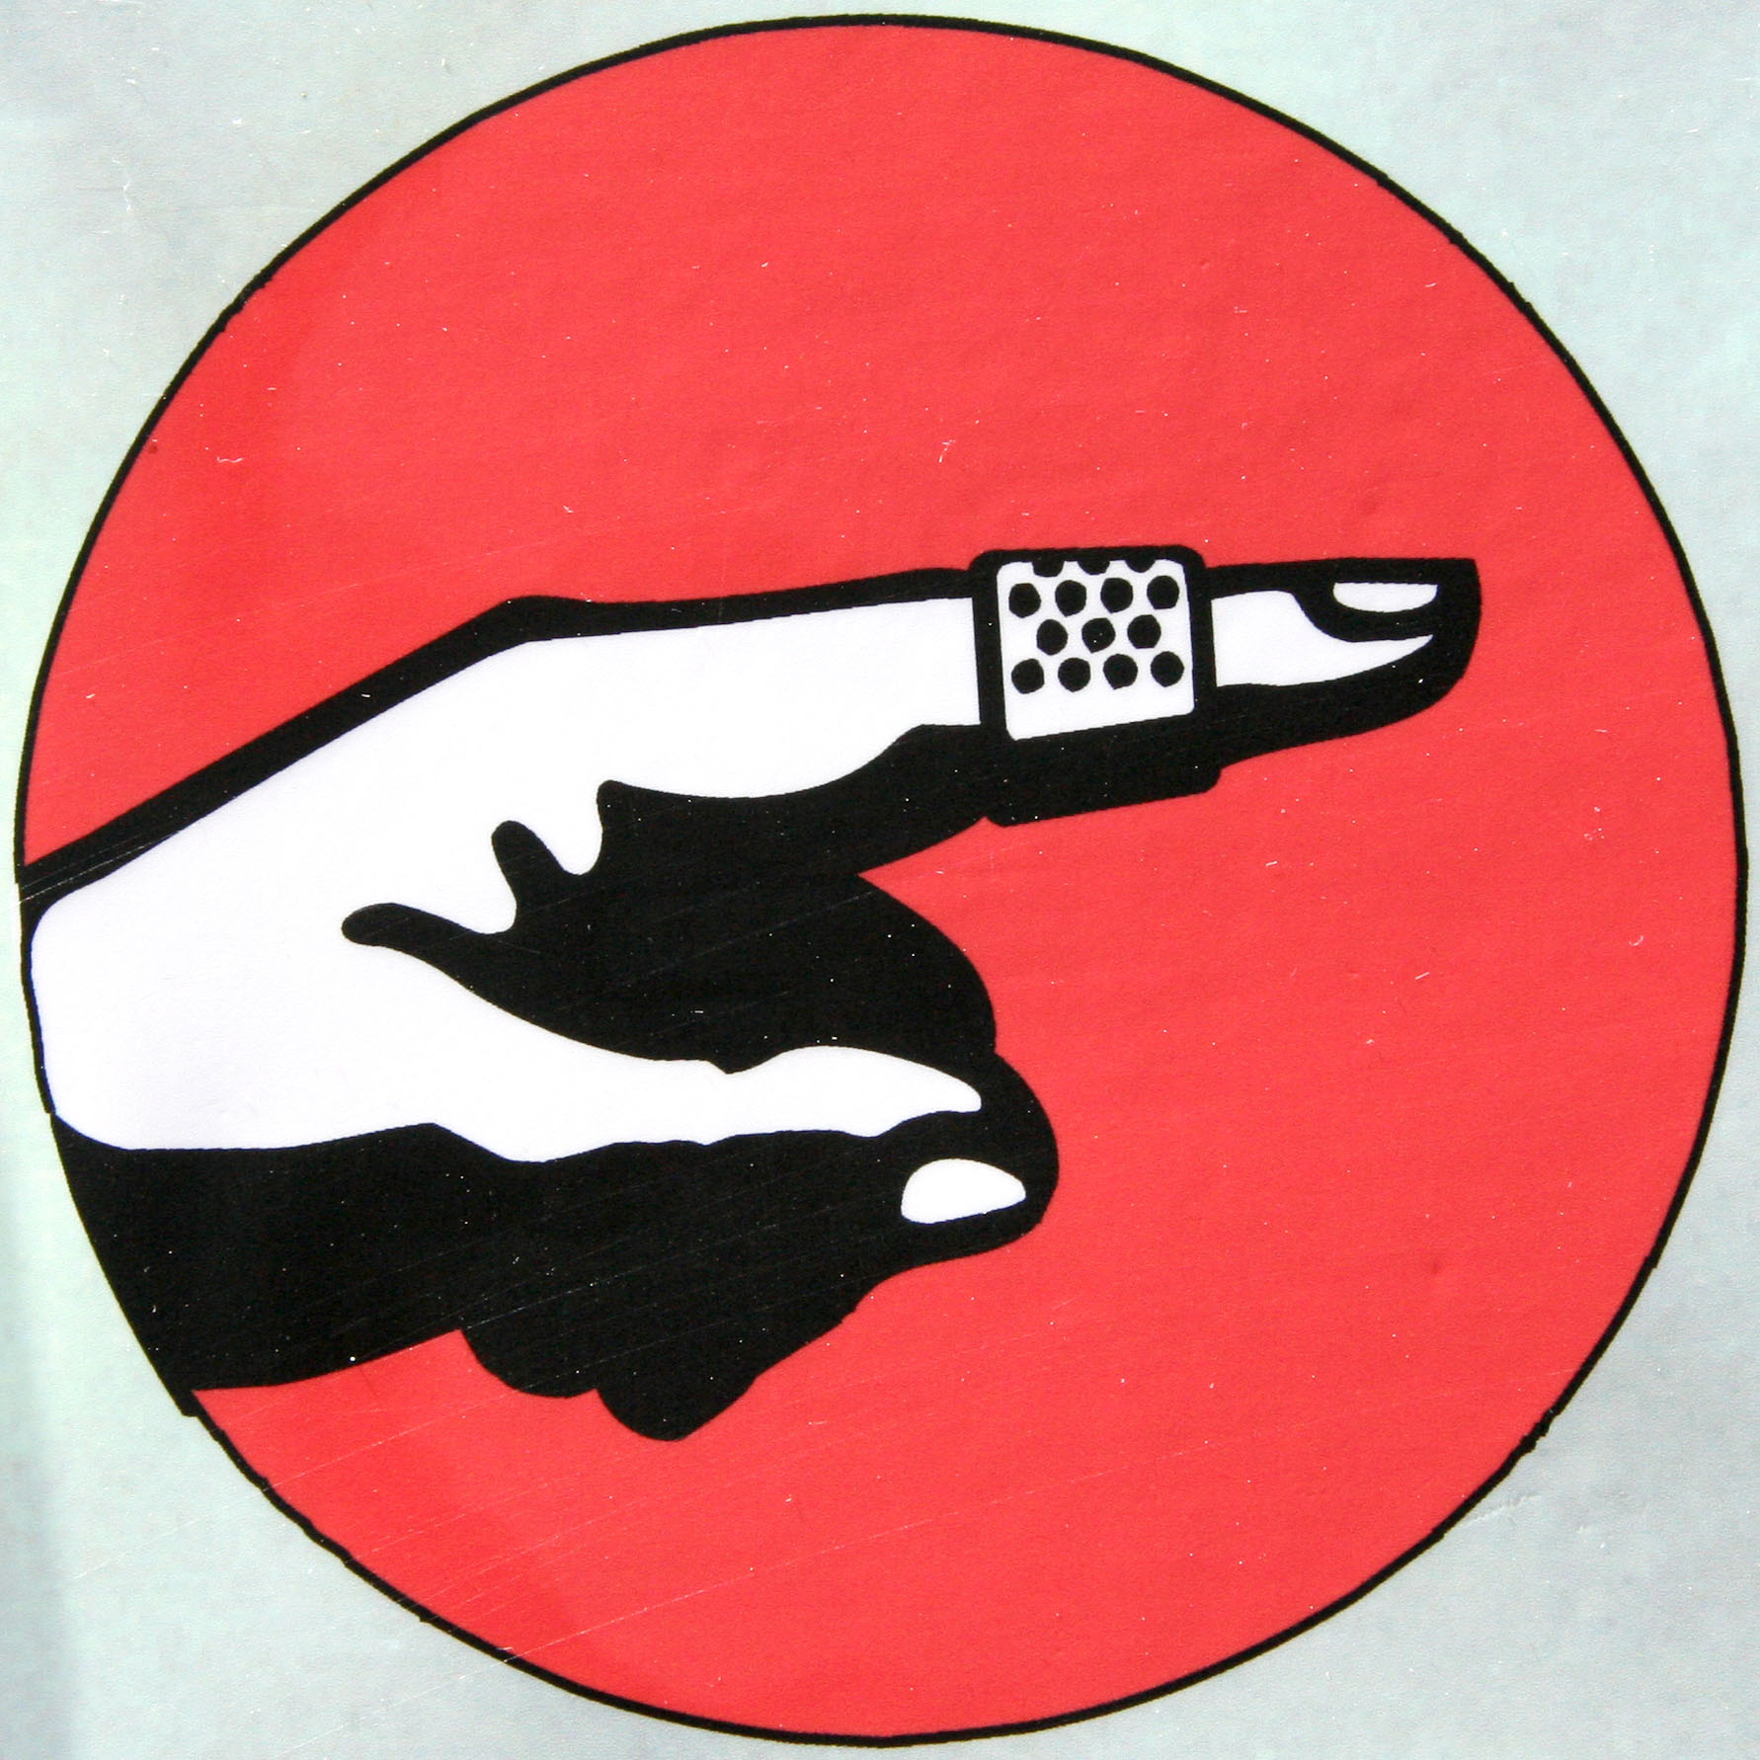
Microaggressions: Constant Inequality
Microaggressions are under-reported
Harm caused because your identity is not considered "the default"
e.g. disability, race, gender
May happen daily
Invisible to the "default" identity
Death by 1,000 paper cuts
CC BY Andrew McGill

Slide 18
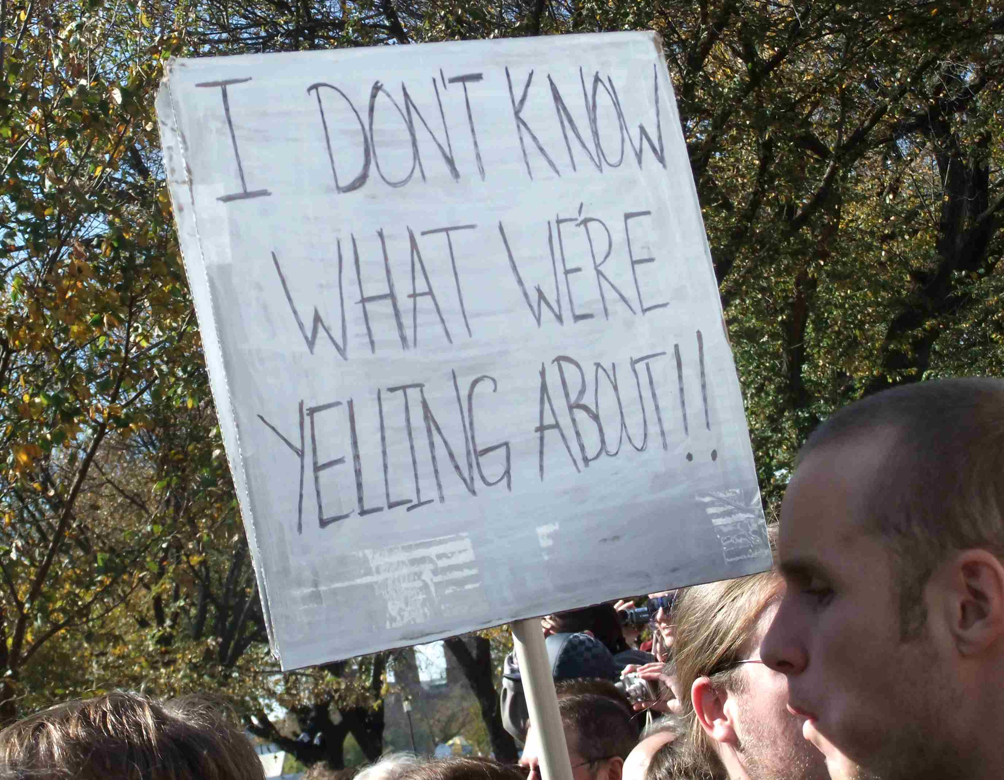
Personal Conflicts
Not all conflicts will be a Code of Conduct violation
Communication breakdown
Is this a pattern?
Know emotional and verbal abuse behaviors: http://outofthefog.website/traits/
CC BY Martha Soukup

Slide 19
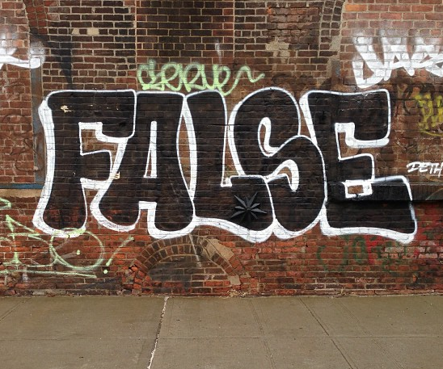
What about False Reporting?
What does a reporter have to lose?
Community
Career
Safety & mental health
Society favors reported person
less likely to face consequences
Microaggressions & sexual harassment are under reported
Believe reporters by default
CC BY Adam Lehman

Slide 20
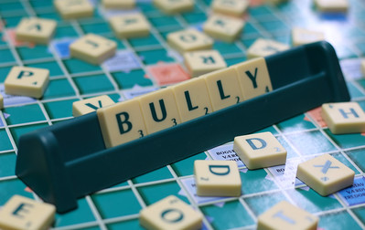
Reversed Power Dynamics
Be cautious of when the power dynamic is reversed:
"racism against white people"
"sexist discrimination of men"
other "reverse-isms"
Reporting process can be used to harass minorities
"Our CoC Committee determined this was not a Code of Conduct violation"
CC BY Jesper Sehested
Pluslexia.com

Slide 21
(Break)
Once you're back,
write "Back" in the chat
Following up on
Incident Reports

Slide 22
Evaluating Reports Risk vs. Impact
Risk:
physically unsafe?
impacts mental health?
risk of behavior being repeated?
Impact:
number of witnesses
authority / leadership of reported person
impact to people from marginalized groups

Slide 23
Evaluating Risk: Examples
 | Low Risk | High Risk
Low Impact | Inappropriate comment in private conversation | Repeated inappropriate comments after warning
High Impact | Racist "joke" during a presentation or in public channel | Stalking Sexual assault

Slide 24
Potential Consequences
Warning
Final Warning
Removal from leadership positions
Do not interact with reporter
Temporary Ban
Permanent Ban

Slide 25
Evaluating Risk: Examples
 | Low Risk | High Risk
Low Impact | Inappropriate comment in private conversation | Repeated inappropriate comments after warning
High Impact | Racist "joke" during a presentation or in public channel | Stalking Sexual assault

Slide 26
Deciding Response: Examples
 | Low Risk | High Risk
Low Impact | Issue warning | Monitor and document patterns of behavior, warn or temporary ban, remove from leadership
High Impact | Reprimand, removal of offensive material Public response from staff or organization | Permanent Ban

Slide 27
Before Speaking to a Reported Person
Write down:
Their behavior and impact
A plan to change their behavior
Consequences for their behavior (?)
What will happen if they don't agree to modify their behavior?
Who can they appeal the decision to?

Slide 28
Common responses to being reported
Defensiveness
Denial
Blame shifting
Seeking reassurance
Apology
Manipulation
Emotion CC BY 2.0 Osamu Kaneko

Slide 29
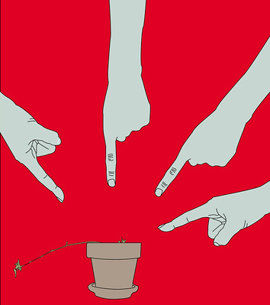
"Calling in" vs "Calling Out"
Minimize number of incident responders
Use teaming language:
our community
we need your help
Shared community goals:
collaboration
constructive communication
Practice new skills privately
Blame CC BY 2.0周小逸 Ian

Slide 30
Following up with the reported person: BIRDS
Go to a private place / private message or video chat
Have an exit plan. Bring another responder if a ban is likely.
State what their Behavior was without judgment words
State the Impact on the reporter or community
Allow the reported person to Respond
Don't reassure or allow the reporter to be contacted
Set a plan to change their behavioral
Offer to relay any apologies
Notes:
“Hi, can I speak with you privately?”
“That's not appropriate.”
“They asked you to stop.”
“This is a private venue.”

Slide 31
Practice:
Following up with
the Reported Person

Slide 32
Discussion
What questions came up?
For the incident responder:
What was hard, complex, or complicated?
For the reported person:
What did the incident responder do well?
What techniques did they use?
Any effective phrases?

Slide 33
Following up after an incident
Try to talk to everyone impacted
May need a public statement
Transparency reports
Whisper networks exist
Document the incident
May need to notify volunteers

Slide 34
Q&A

Slide 35
Advanced Topics

Slide 36
Systemic Inequality
Collective lack of action
Biased harmful policies or systems
Negatively impacts marginalized groups
Example: No 'religious symbols' policies
Must choose between a headscarf & education/jobs
2x more Muslim girls don't go to secondary school in France
Source: https://www.washingtonpost.com/politics/2019/06/03/how-will-austrias-new-headscarf-ban-affect-muslims/?noredirect=on

Slide 37
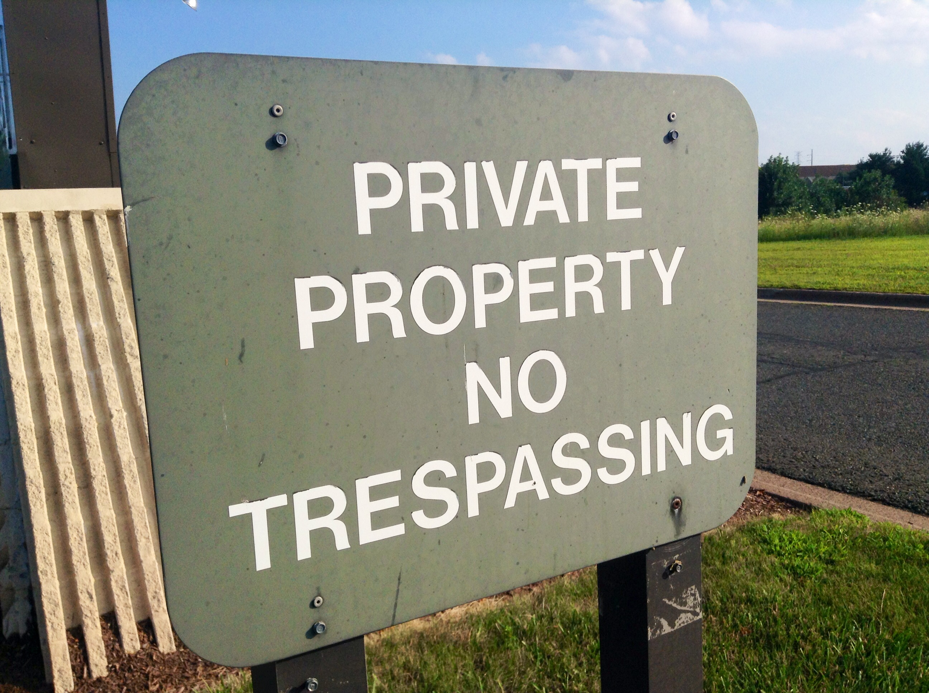
Dealing with Unwelcome Attendees
“You aren’t permitted to attend the conference”
Don’t provide details
Ask them to leave
“This is a private venue”
Get onsite help
Report for trespassing
Know your local trespassing laws
CC BY Mike Mozart

Slide 38
Dealing with Weapons Policy Violations
“Weapons are not allowed at our conference”
Ask them to leave
Come back without the weapon
Do not argue, be firm
Ask staff, response team, security to help
If there is a safety risk, call 911

Slide 39
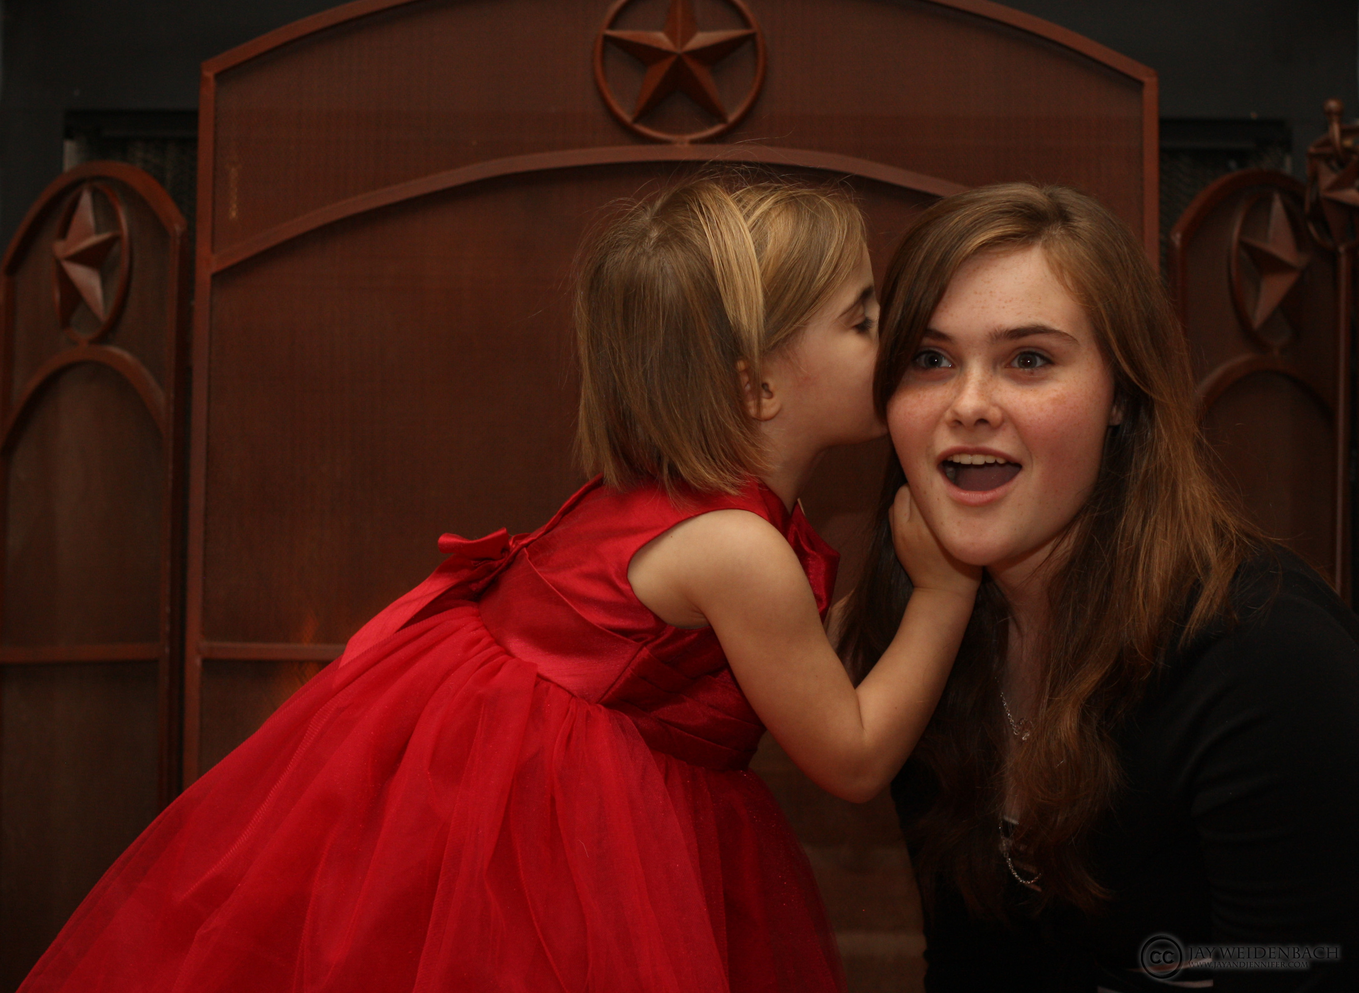
Conflicts of Interest
Is anyone a friend or coworker?
conference staff or volunteers
incident response team
papers committee
sponsors
Review leadership positions for potential leaks:
other incident responders
volunteers & staff
papers committee
board members
CC BY Jay Weldenbach

Slide 40
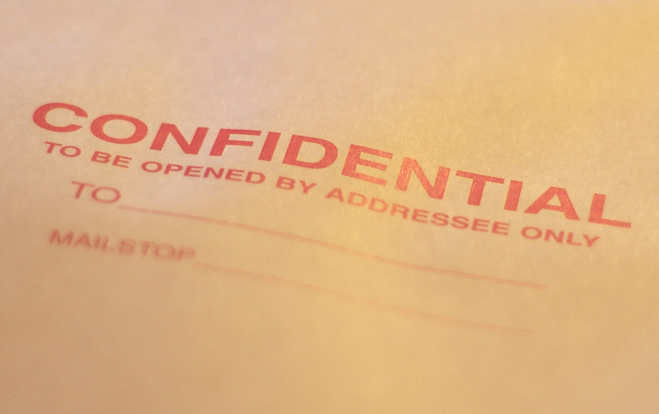
Confidentiality Issues
Reporter fears retaliation
NDAs & severance
Police Investigation
Limit incident docs access
Ask around (discretely)
Often multiple incidents
Other grounds to dismiss
CC BY Casey Marshall

Slide 41
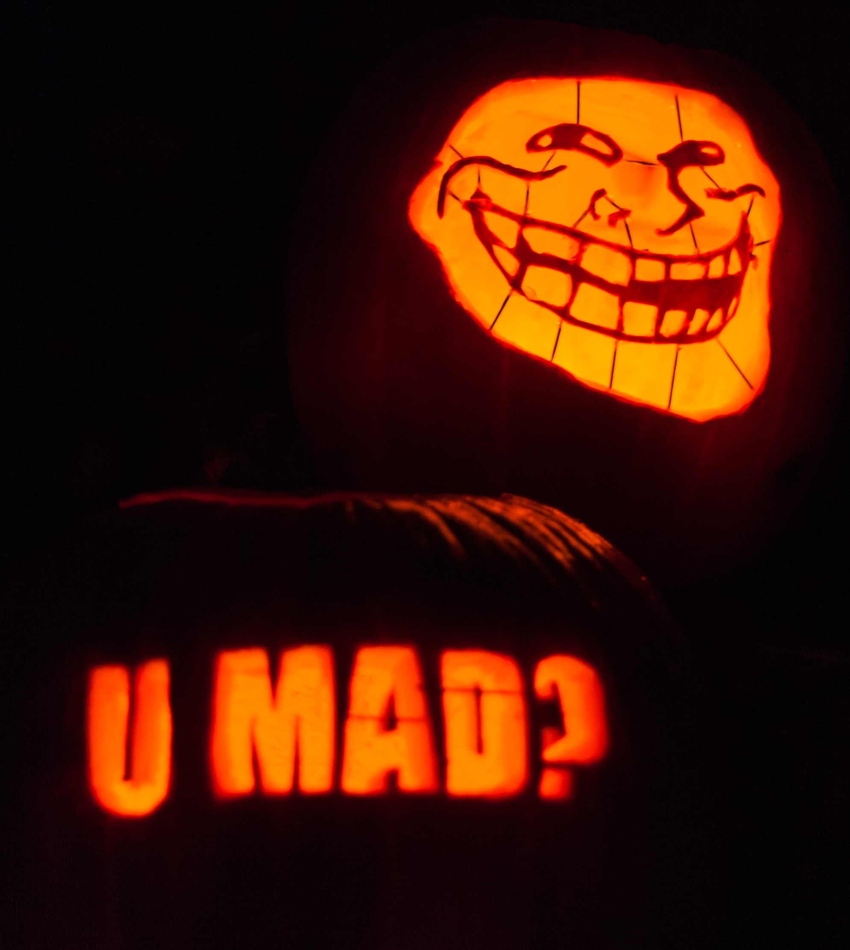
Known Harassers
Not just internet trolls
Stalkers do show up
Power plays & disruption
Have a mitigation plan
Strict confidentiality plan
Ensure attendee safety
CC BY Paul VanDerWerf

